Slide 1

MEDGUARD

Slide 2

CREDIT CARD FRAUD DETECTION
Group No. 14
Gopal Chavan(250243025010)
Megharani Pol(250243025023)
Saurav Mahto (250243025036)
Arbaj Shaikh (250243025037)
Guided By:
Milind Kapse sir

Slide 3

Understanding Credit Card Fraud and Its Impact
Overview of Credit Card Fraud Problem
Common Fraudulent Activities:
Unauthorized transactions using stolen card details.
Card-not-present fraud through online purchases.
Account takeover by fraudsters accessing user credentials.
Synthetic identify fraud by combining real and fake information.

Slide 4

Brief Introduction to the Credit Card
Fraud
Detection
The Credit Fraud Detection System is a robust and intelligent framework designed to detect and prevent fraudulent transactions within credit card payment systems. It leverages advanced analytics, machine learning algorithms, and behavioral modeling to identify suspicious activities in real-time or through historical transaction data.
By continuously analyzing customer spending behavior, transaction patterns, and contextual data such as time, location, and merchant category, Credit builds a comprehensive baseline profile for each user. It then monitors incoming transactions to detect anomalies or deviations that may signal potential fraud.
More than just a detection tool, Credit plays a critical role in enhancing the security and trustworthiness of financial systems. It supports financial institutions in safeguarding customer assets, improving fraud response time, and ensuring compliance with regulatory standards.

Slide 5
METHODOLOGY
Data collection
Data Preprocessing & Data Balancing
Deployment
Data Modeling

Slide 6






Data Collection
Data Preprocessing
Data Visualization
Data Balancing
Database
Model Building
Deployment
FLOW DIAGRAM

Slide 7
Data Collection
Source
The Dataset was obtained from Kaggle.
Titled: “Credit Card Fraud Detection”.
Published by Emre Bayır.
Dataset Details
Total Transactions: 1296675
Fraudulent Transactions: 7506
Non-Fraudulent Transactions: 1289169
Fraud Rate: ~0.6% (Highly Imbalanced)

Slide 8
Data Preprocessing
Environment
Framework: Apache Spark (PySpark)
Language: Python
Scale: Optimized for handling large-scale datasets efficiently.
Null Values Check
Verified dataset had no missing values.
Ensured data completeness for all records.
Feature Engineering
Created new features like:
Distance → Estimated location-based distance.
amt_per_capita → Ratio of transaction amount per user behavior.
One Hot Encoding and Frequency encoding.
Dropped unnecessary columns.

Slide 9
Data Modeling
XGBoost
Random
Forest
Employed for its high performance and speed in handling large datasets with boosting techniques.
Used for its robustness and ability to reduce overfitting through ensemble learning.

Slide 10
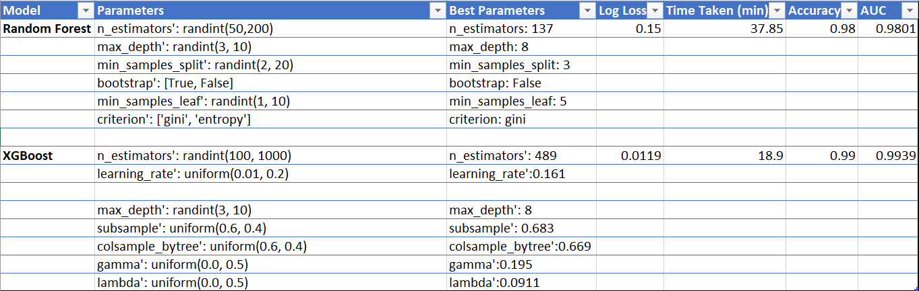
Model Performance & Hyperparameter Tuning

Slide 11
Overview of
XGBoost
Advantages
High Performance: It's known for its speed and superior predictive power, often winning machine learning competitions.
Scalability: XGBoost is highly scalable, making it efficient on large datasets.
XGBoost (eXtreme Gradient Boosting) is an advanced implementation of gradient boosting that's highly efficient and flexible. It's a powerful machine learning algorithm used for both regression and classification tasks.
Key Features:
Parallelization: XGBoost can parallelize the tree-building process, which significantly speeds up training. It does this by using a column block for parallel computation.
Regularization: It includes both L1 (Lasso) and L2 (Ridge) regularization to prevent overfitting. This helps control the complexity of the model and improves its generalization to new data.
Use Case
Widely used in various data science and machine learning applications, including fraud detection, credit risk analysis, and customer churn prediction.

Slide 12
Deployment
Streamlit
Open Source Python library.
Use for building interactive web apps directly from scripts.
Real-Time Prediction
Displays immediate fraud prediction result after user input submission.
Shows prediction probability to increase transparency.
Integrate Visualizations
Integrated Tableau dashboard into Streamlit app using Tableau Public link.
Provided interactive fraud analysis visualizations directly within the app interface.
Deployed the app using Streamlit Cloud for easy, free, and shareable
web access.

Slide 13
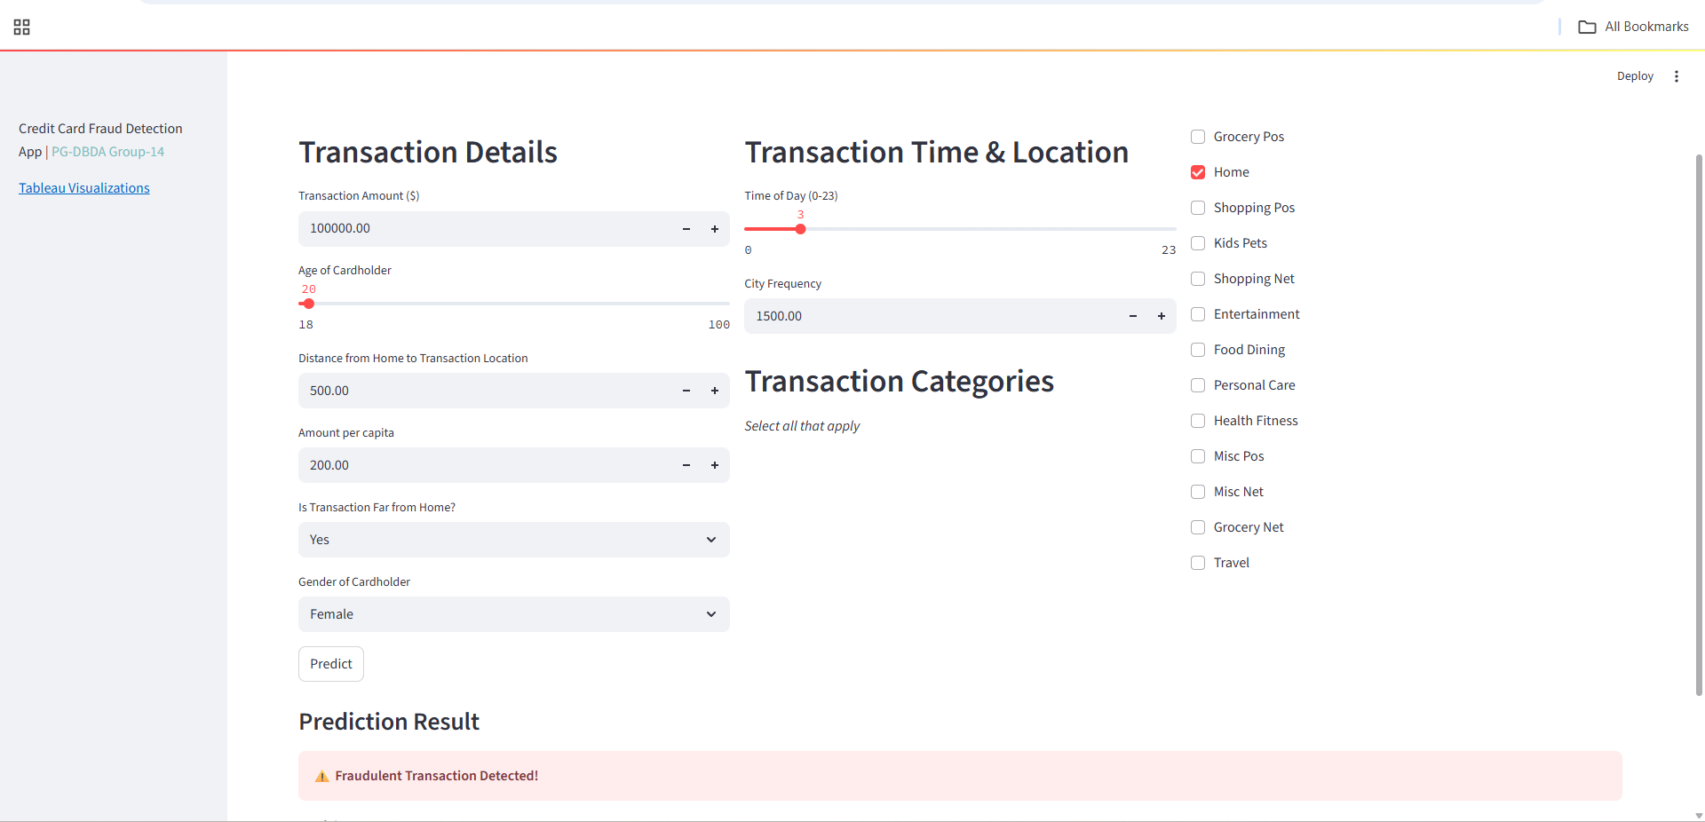
PREDICTION PAGE

Slide 14
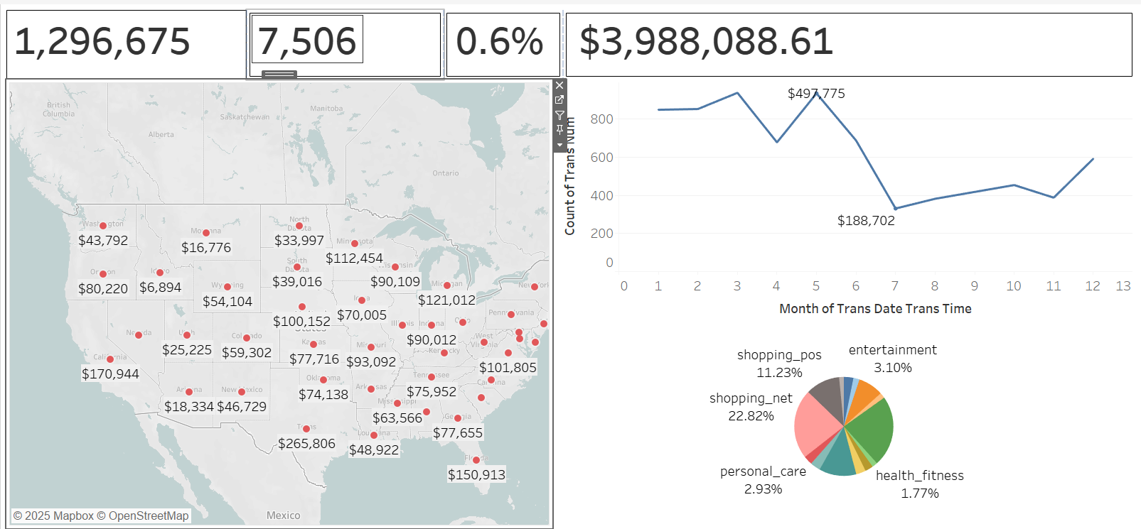
TABLEAU DASHBOARD

Slide 15
Conclusion
The XGBoost model demonstrated exceptional performance in detecting credit card fraud, achieving an accuracy of 99% and an AUC of 0.9939.
The model's success was driven by its ability to handle imbalanced datasets, its efficient tree-boosting algorithm, and strategic hyperparameter tuning.
The insights gained from this analysis can enable financial institutions to make data-driven decisions, enhance security protocols, and effectively mitigate fraudulent transactions.

Slide 16
Thank you

